Slide 1
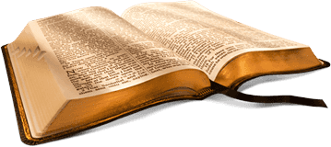
BIBLE STUDY
“WORK OUT YOUR OWN SALVATION
WITH FEAR AND TREMBLING”
Philippians 2:1-13
Deuteronomy 3:24-28
Compiled Dr. Elder K. A. Davidson
Cited - Internet

Slide 2
Philippians 2:1-13
¹ If there be therefore any consolation in Christ, if any comfort of love, if any fellowship of the Spirit, if any bowels and mercies, ² Fulfil ye my joy, that ye be likeminded, having the same love, being of one accord, of one mind. ³ Let nothing be done through strife or vainglory; but in lowliness of mind let each esteem other better than themselves. ⁴ Look not every man on his own things, but every man also on the things of others. ⁵ Let this mind be in you, which was also in Christ Jesus: ⁶ Who, being in the form of God, thought it not robbery to be equal with God: ⁷ But made himself of no reputation, and took upon him the form of a servant, and was made in the likeness of men: ⁸ And being found in fashion as a man, he humbled himself, and became obedient unto death, even the death of the cross. ⁹ Wherefore God also hath highly exalted him, and given him a name which is above every name: ¹⁰ That at the name of Jesus every knee should bow, of things in heaven, and things in earth, and things under the earth; ¹¹ And that every tongue should confess that Jesus Christ is Lord, to the glory of God the Father. ¹² Wherefore, my beloved, as ye have always obeyed, not as in my presence only, but now much more in my absence, work out your own salvation with fear and trembling. ¹³ For it is God which worketh in you both to will and to do of his good pleasure.

Slide 3
Deuteronomy 3:24-28
²⁴ O Lord God, thou hast begun to shew thy servant thy greatness, and thy mighty hand: for what God is there in heaven or in earth, that can do according to thy works, and according to thy might? ²⁵ I pray thee, let me go over, and see the good land that is beyond Jordan, that goodly mountain, and Lebanon. ²⁶ But the Lord was wroth with me for your sakes, and would not hear me: and the Lord said unto me, Let it suffice thee; speak no more unto me of this matter. ²⁷ Get thee up into the top of Pisgah, and lift up thine eyes westward, and northward, and southward, and eastward, and behold it with thine eyes: for thou shalt not go over this Jordan. ²⁸ But charge Joshua, and encourage him, and strengthen him: for he shall go over before this people, and he shall cause them to inherit the land which thou shalt see.

Slide 4
DISCLAIMER:
The scripture in Philippians that we read, is NOT saying you can create you own SALVATION; nor is it saying you can do whatever you WANT to DO or WORK for your SALVATION.
The bible admonished us to RIGHTLY DIVIDE THE WORD OF TRUTH!

Slide 5
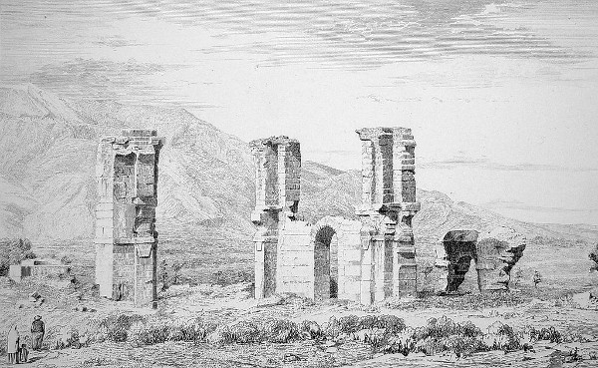
Paul’s Letter to the Philippians

Slide 6
When was it written?
Paul was a prisoner when he wrote this letter.
He may have been imprisoned in
Caesarea (A.D. 57-59),
Rome (A.D. 59-61),
or Ephesus (A.D. 53-55) while he wrote it.

Slide 7
To whom was it written?
The Christian church in the city of Philippi, was one of the leading cities in the district of Macedonia.
Placed strategically on the Egnatian Way, Philippi enjoyed important privileges within the Roman empire:
autonomous government
and immunity from tribute.

Slide 8
Why was it written?
The Philippian church had sent the imprisoned Paul a gift by a messenger named Epaphroditus.
When Epaphroditus fell ill while performing his duties, Paul decided to send him back to Philippi and asked that the church receive him with joy and hold him in high regard.
This letter stands out as one of the most personal that Paul wrote.
It is joyful in nature and doesn’t harshly rebuke the congregation.
Paul shows his immense gratitude to the church by thanking them for their generous gifts.

Slide 9
WORK OUT YOUR OWN SALVATION
WITH FEAR AND TREMBLING
What does God mean when the Bible says that we are to work out our own salvation and to do it with fear and trembling?
What is the meaning of the words fear and trembling?

Slide 10
FEARING GOD IS TRUE WISDOM
The fear of God is a reverential, holy, deep respect of God and honoring Him and His Word, the Bible.
To fear God is really the beginning of wisdom (Psalm 111:10; Prov 9:10)
Anyone that takes to heart what God says, takes to him or herself true wisdom (Rom 11:33) (1 Cor 1:25; 1 Cor 3:19).
The point is that you will find true wisdom in the Bible
and a man or woman who reads the Bible daily
will begin to understand,
to at least a certain extent, the mind of God and what God’s will is for us.
That is a wise thing to do.

Slide 11
TREMBLING BEFORE GOD
Isaiah 66:2 “this is the one to whom I will look: he who is humble and contrite in spirit and trembles at my word.”
God actually looks at those or gives regard to those who are humble and contrite (broken) in their human spirit and that tremble at His Word which is revealed in the Bible.
God resists the proud – James 4:6
God is literally at war – James 4:6
God has regard - the lowly in spirit gain honor” (Prov 29:23).
The LORD is close to the brokenhearted and saves those who are contrite spirit” (Psalm 34:18).

Slide 12
FEAR AND TREMBLING
For those who fear God and tremble at His Word,
God will look upon,
give regard to,
save those,
provide grace to,
and be near to.
Fearing God is taking God seriously as He speaks in the pages of the Bible and then fearing the consequences of disobedience to His Word.
Trembling at His Word is to have the utmost regard for Scripture so submit and “Humble yourselves, therefore, under the mighty hand of God so that at the proper time he may exalt you” (1 Pet 5:6).

Slide 13
WORKING OUT OUR OWN SALVATION
Philippians 2:12-13 “12 Wherefore, my beloved, as ye have always obeyed, not as in my presence only, but now much more in my absence, work out your own salvation with fear and trembling. 13 For it is God which worketh in you both to will and to do of his good pleasure.”
DISCLAIMER…
Paul ties in fear and trembling with the effort
that we must POUR into our SANCTIFICATION or SALVATION.
He was exhorting them by telling them that they should be “holding fast to the word of life, so that in the day of Christ I may be proud that I did not run in vain or labor in vain” (Phil 2:16).

Slide 14
This “holding fast to the word of life” can mean none other than
…holding on to the Word of God, the Scriptures, and in a duel way,
…the Word of God in Jesus Christ (John 1).
Conclusion…

Slide 15
There is no need to fear for those who have been saved,
but for those who are not saved, they have every good reason to fear for their day of judgment is coming because they have an appointed day to die and be judged
(Heb 9:27
“And as it is appointed unto men once to die,
but after this the judgment:’).

Slide 16
WORKING OUT OUR OWN SALVATION
WHAT WE SHOULD POUR into our SANCTIFICATION /SALVATION:
1 …comfort of love, fellowship of the Spirit, bowels and mercies,
2 …be likeminded, having the same love, being of one accord, of one mind.
3…nothing be done through strife or vainglory; but in lowliness of mind let each esteem other better than themselves.
4 Look not every man on his own things, but every man also on the things of others.

Slide 17
WORKING OUT OUR OWN SALVATION
WHAT WE SHOULD POUR into our SANCTIFICATION /SALVATION:
⁵ Let this mind be in you, which was also in Christ Jesus:
⁷ …made himself of no reputation, and took upon him the form of a servant,
⁸ …humbled himself, and became obedient unto death, even the death of the cross.
⁹ …always obeyed, in presence and much more in my absence, work out your own salvation with fear and trembling.
¹³ For it is God which worketh in you both to will and to do of his good pleasure.
He was exhorting them by telling them that they should be “holding fast to the word of life, so that in the day of Christ I may be proud that I did not run in vain or labor in vain” (Phil 2:16).

Slide 18
1 Kings 2:4 – “That the Lord may continue his word which he spake concerning me, saying, If thy children take heed to their way, to walk before me in truth with all their heart and with all their soul, there shall not fail thee (said he) a man on the throne of Israel.”
Psalm 86:11 - Teach me thy way, O Lord; I will walk in thy truth: unite my heart to fear thy name.”
3 John 4 – “I have no greater joy than to hear that my children walk in truth.”
Galatians 5:16 - “ This I say then, Walk in the Spirit, and ye shall not fulfil the lust of the flesh.”

